Slide 1

Marketing Strategy Summary
Most Influential Check-In Feature
Quiet and Restful Environment
(36 customers)
75%
Most Disappointing Features
Comfortable and Clean Rooms
(16 disappointments)
62%
Top Customer Satisfaction Driver
Quiet and Restful Environment
(32 customers)
89%
Modern Fitness Facilities
(13 disappointments)
59%
Most Frequently Met Expectation
Fast and Reliable Wi-Fi
(21 customers)
Family-Friendly Services
(11 disappointments)
79%
81%
Stylish Interior Designer
(10 disappointments)
90%
Surprise Delight
Delicious Breakfast
(1 customer)
1
Customer

Slide 2
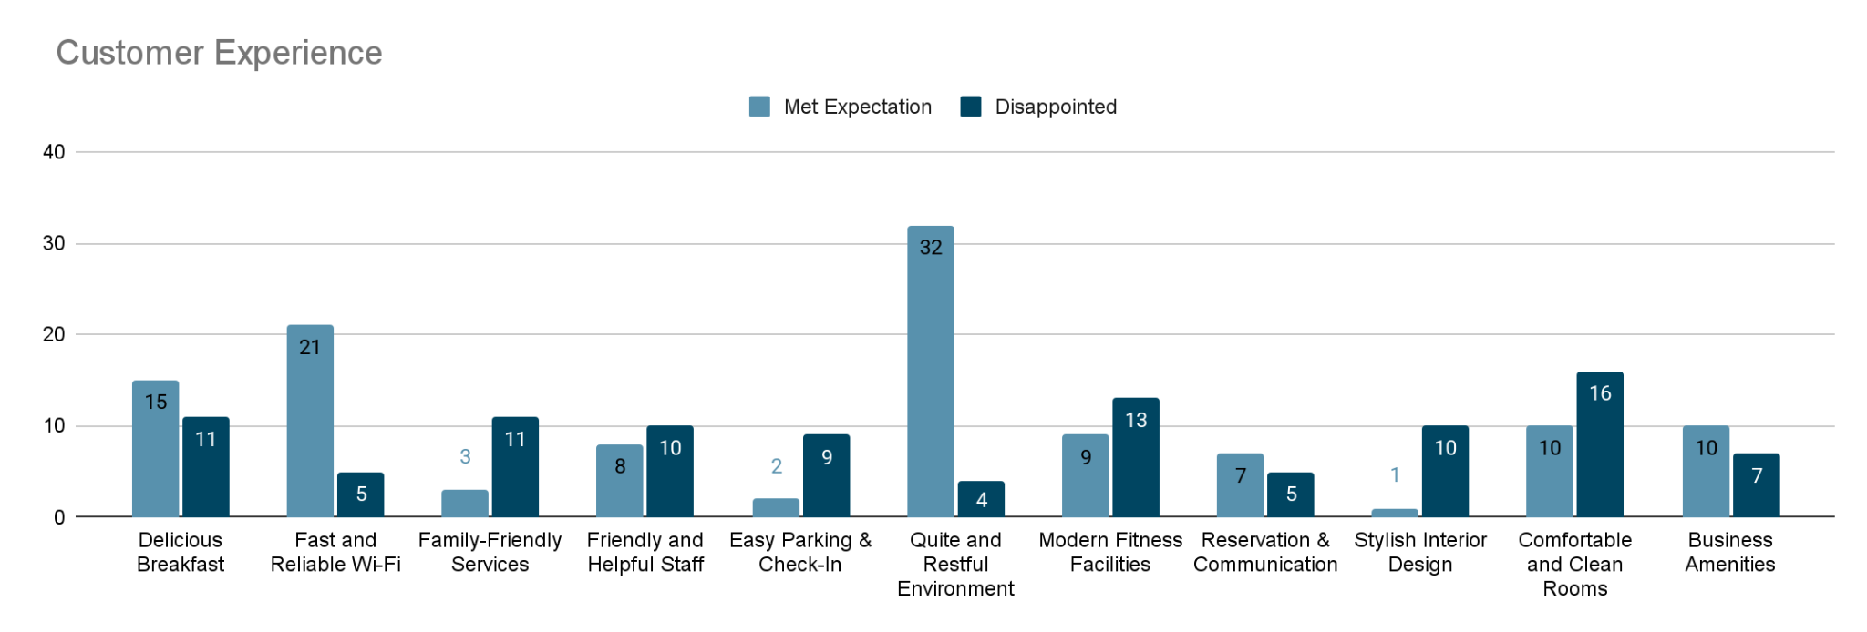
Customer Experience & Feedback
There’s a clear misalignment between customer expectations and experiences for several key features.
Comfortable and Clean Rooms
Among the top 3 check-in reasons but also the most disappointing.
Family-Friendly Services and
Modern Fitness Facilities
underperformed relative to the expectations set during check-in.
Quiet and Restful Environment and Fast and Reliable Wi-Fi
delivering consistent value and enhancing guest satisfaction.

Slide 3
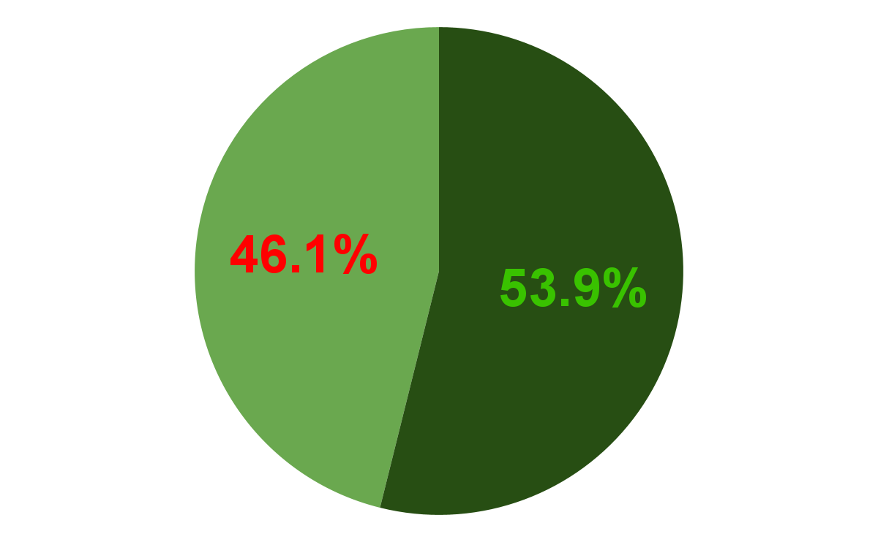
Management Recommendations
Emphasize actual guest wins
Quiet & Restful Environment
brand anchor
(32 of 36)
Fix Underperforming Services
89%
62%
Comfortable & Clean Rooms
Audit housekeeping, room upkeep
(16 of 26)
Fast & Reliable Wi-Fi
feature in digital business campaigns
(21 of 26)
81%
79%
Family-Friendly Services
Clarify offerings, enhance value
(11 of 14)
Improve Staff & Service training
Only 44% found staff as helpful
refresh training, reinforce service culture
(8 of 18)
59%
Modern Fitness Facilities
Impact equipment & accessibility
(13 of 22)
44%

